Slide 1
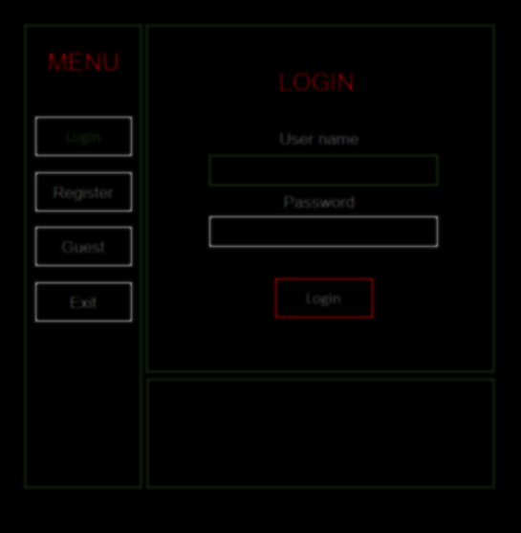
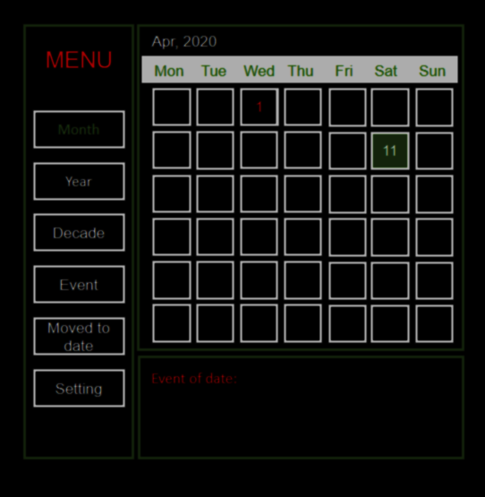
Calendar
TEAM 3
F – Code
Welcome to the Project of our team.

Slide 2
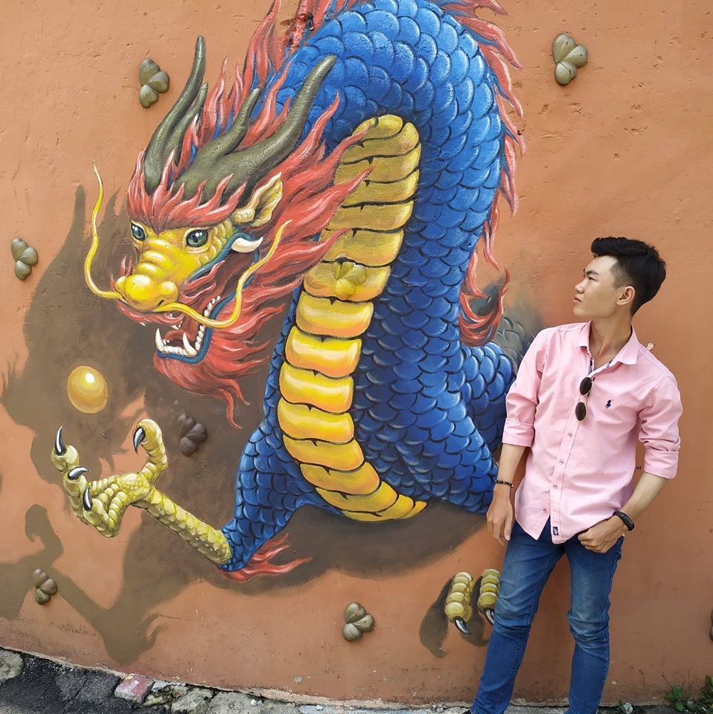
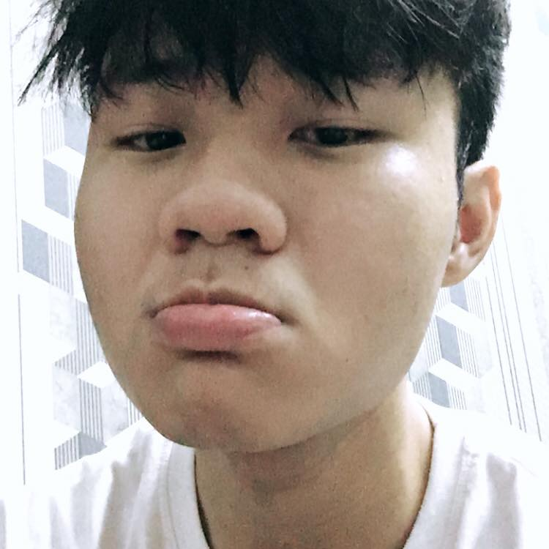
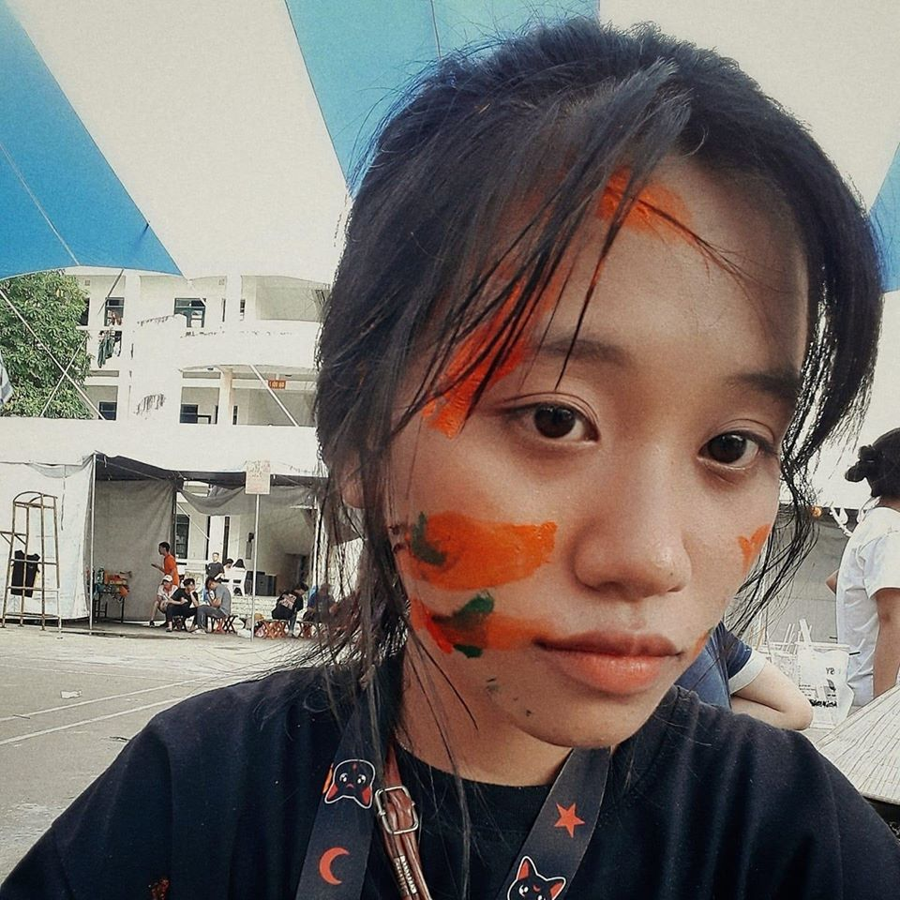

Team
Tran Gia Nguyen
MENTOR
Lam Nguyen
Dang Phuong Anh
Vinh Nguyen
LOGIC BUSINESS
USER INTERFACE
DATABASE
Team 3 Calendar – F code

Slide 3

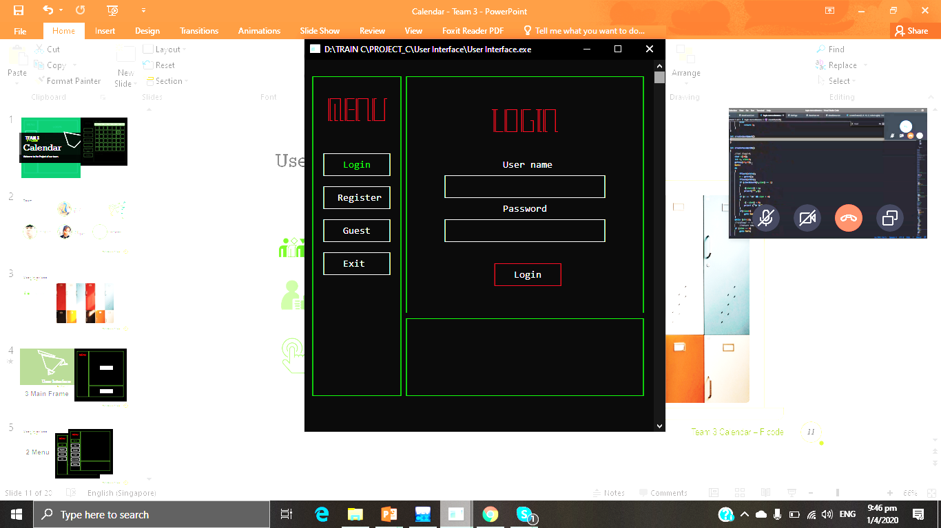

User Interface
Dang Phuong Anh
Diversity
Team 3 Calendar – F code

Slide 4

User Interface
FEATURE
Dang Phuong Anh
3 Main Frame
FEATURE
Team 3 Calendar – F code

Slide 5
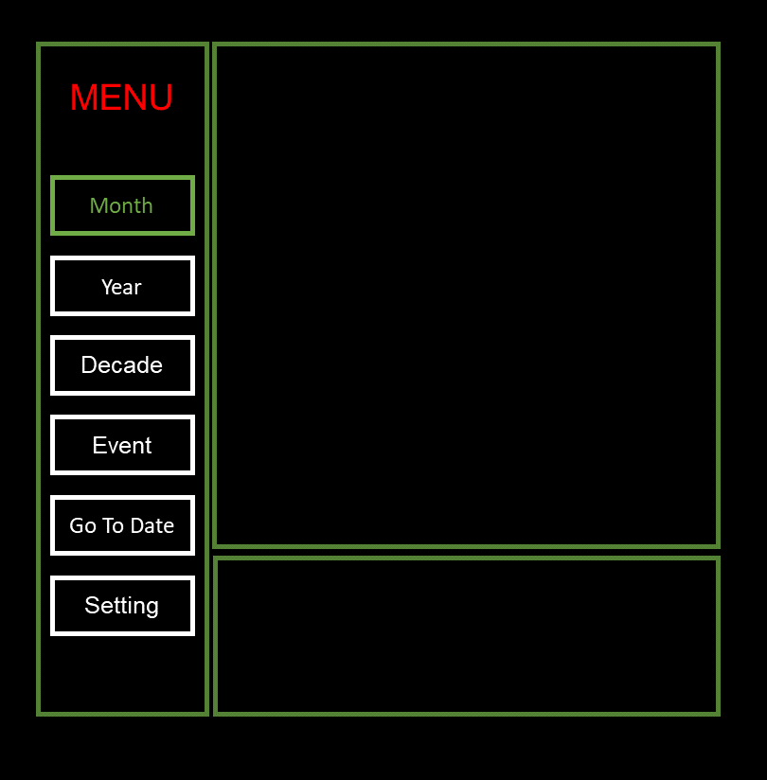
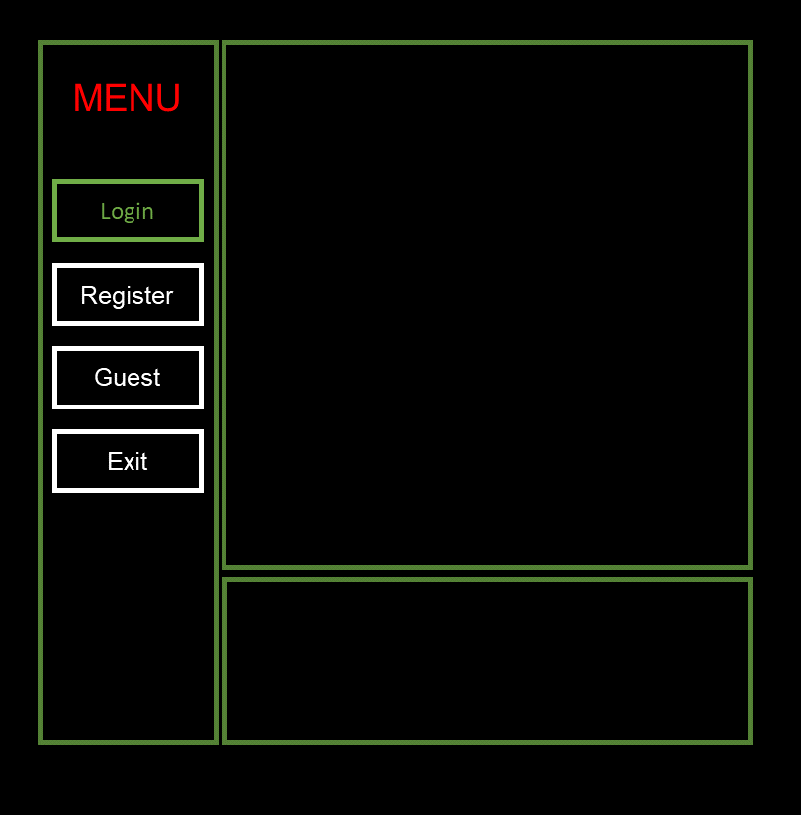
User Interface
Dang Phuong Anh
2 Menu
Allow user to select with Enter key and move with arrow keys
Team 3 Calendar – F code

Slide 6
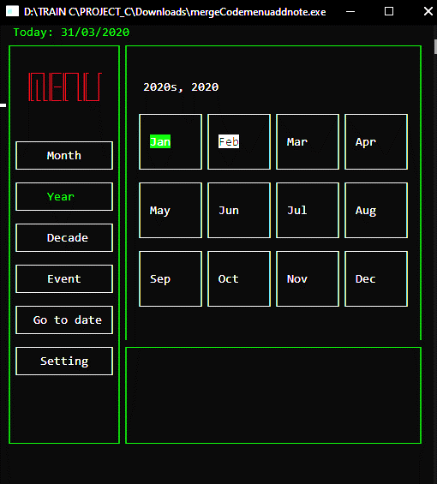
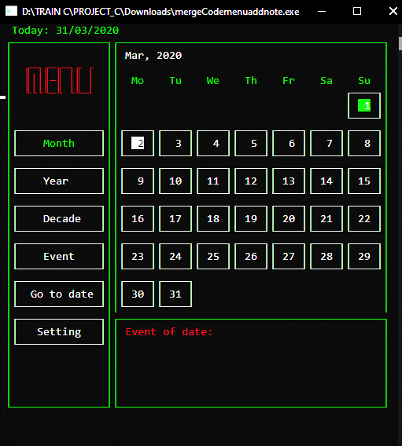
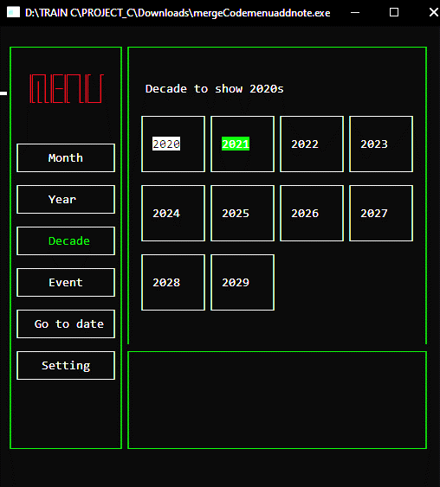
User Interface
Dang Phuong Anh
Month
Year
Decade
Move with the arrow keys to view the day, the month, the year.
Team 3 Calendar – F code

Slide 7

User Interface
Dang Phuong Anh
Diversity
User friendly
Team 3 Calendar – F code

Slide 8
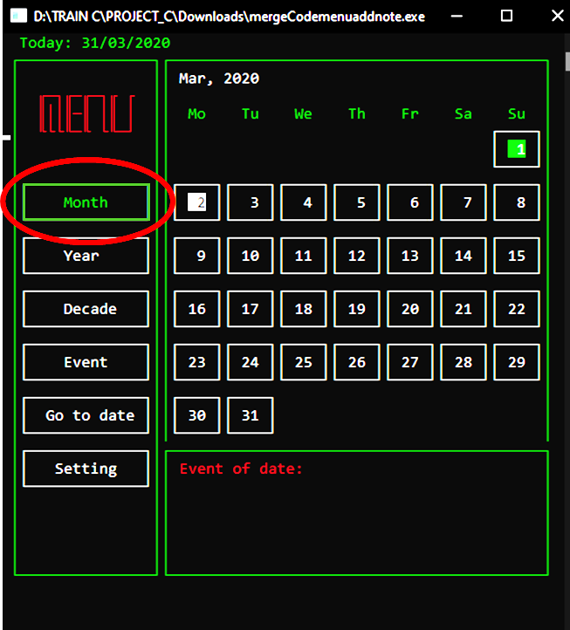
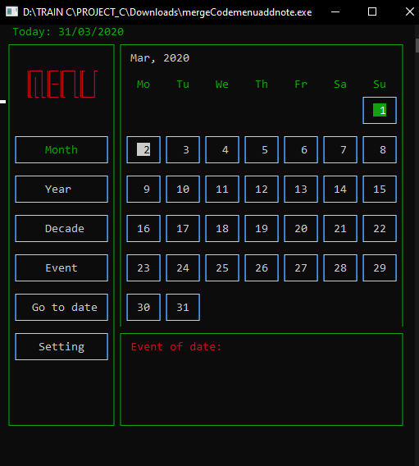
User Interface
Dang Phuong Anh
Enter key
Team 3 Calendar – F code

Slide 9
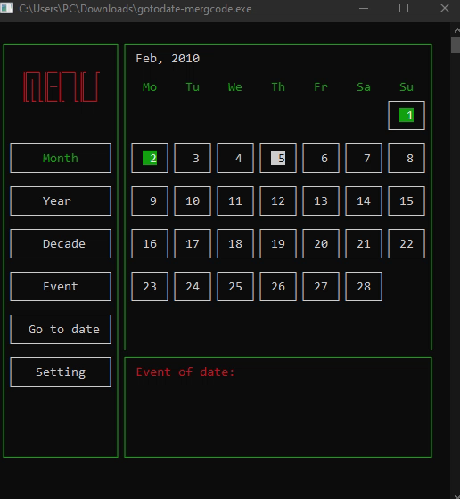
User Interface
Dang Phuong Anh
Team 3 Calendar – F code

Slide 10
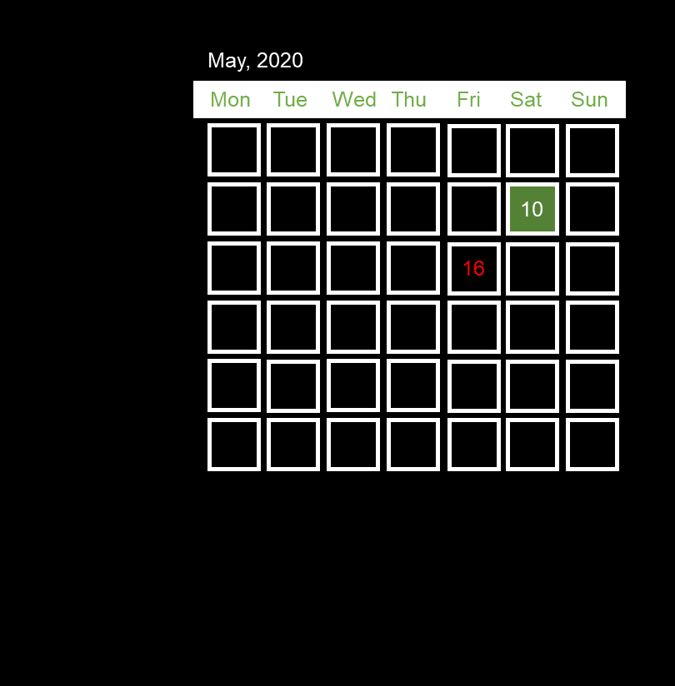

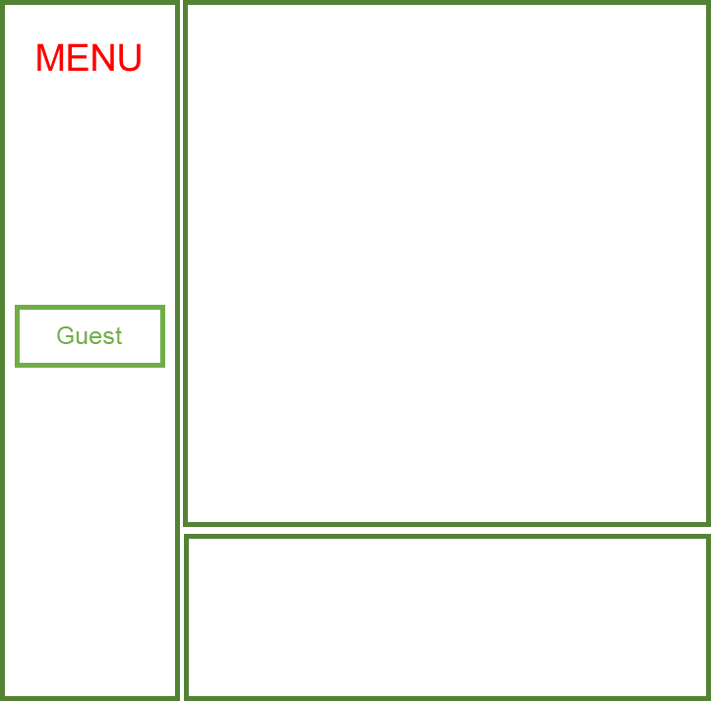
User Interface
Guest
Quick calendar view when users do not want to log in or register.
Please login to use the function!
Dang Phuong Anh
Team 3 Calendar – F code

Slide 11

User Interface
Dang Phuong Anh
Diversity
User friendly
Simple
Easy to use
Team 3 Calendar – F code

Slide 12
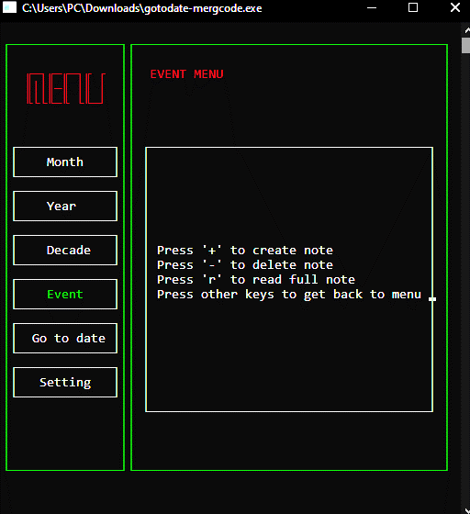
User Interface
Dang Phuong Anh
Specific instructions in each interface, easy to manipulate, easy to use.
Team 3 Calendar – F code

Slide 13
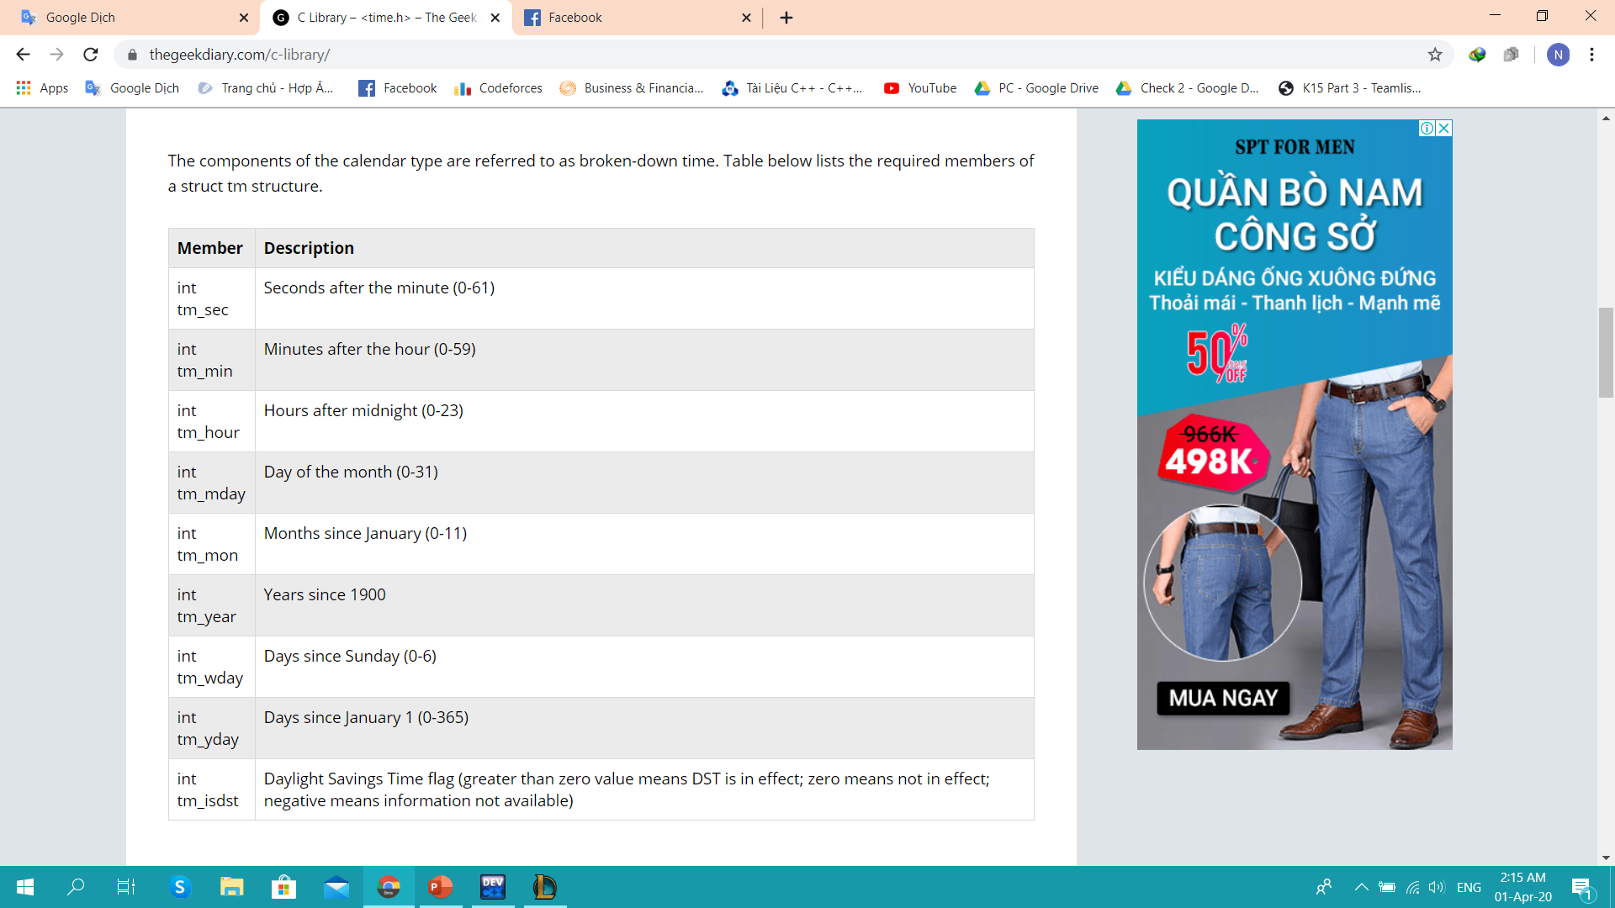
Database
Vinh Nguyen
C Library - <time.h>
Struct
- A user-defined data type.
- Used to group different data types into one data type.
Team 3 Calendar – F code

Slide 14
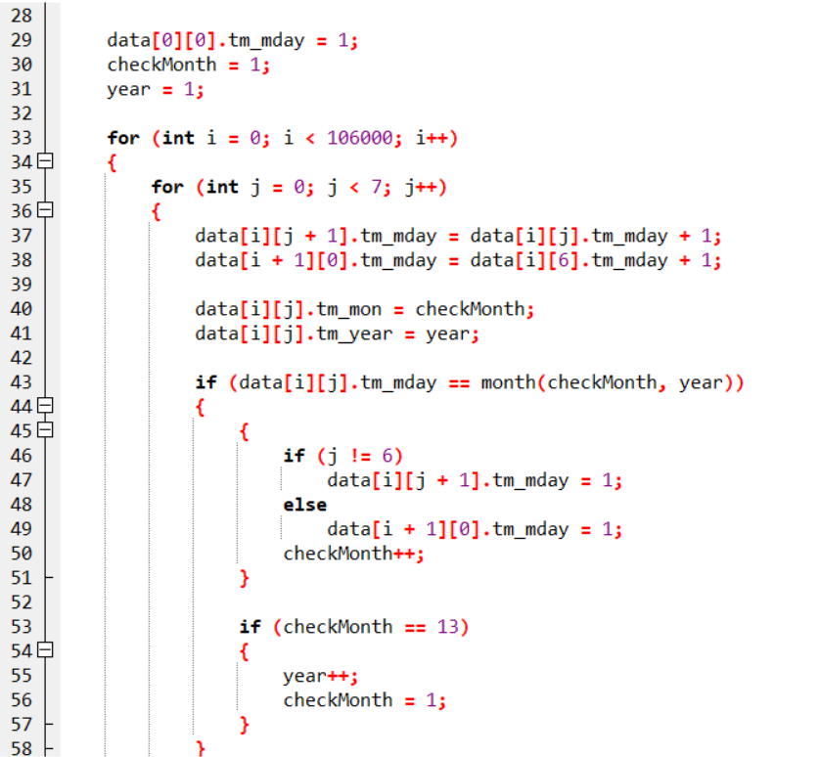
Database
Vinh Nguyen
How to use
name of the variable struct mark dots (.) And the name of the member variable respectively.
Two - dimensional array (2D array)
Team 3 Calendar – F code

Slide 15
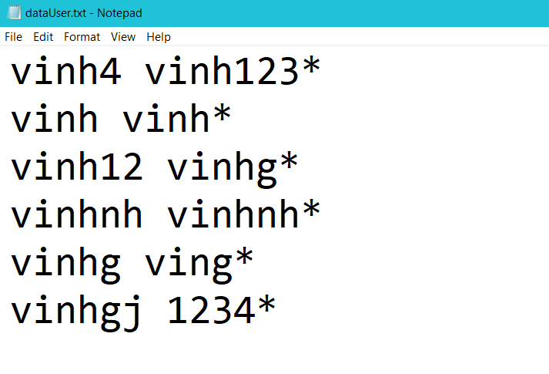

Database
Create an account, login
Read - Write File in C
Mode “a+”.
Compare 2 strings.
Vinh Nguyen
Team 3 Calendar – F code

Slide 16

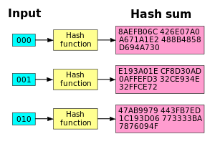
Database
Vinh Nguyen
Increase security
Encryption → hash function
Team 3 Calendar – F code

Slide 17
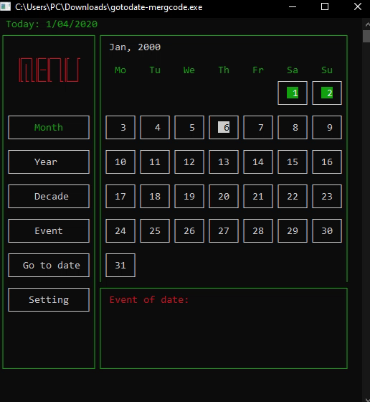
Logic Business
Move and link between month, year and decade
Lam Nguyen
Team 3 Calendar – F code

Slide 18
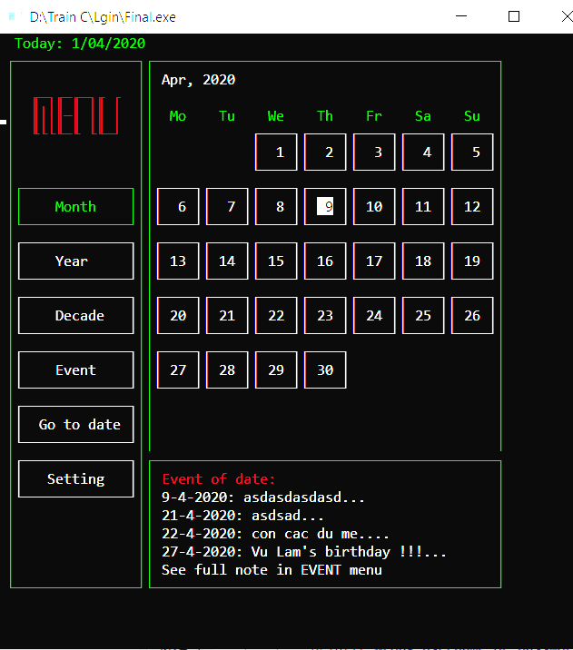
Logic Business
Lam Nguyen
Event of date
Team 3 Calendar – F code

Slide 19
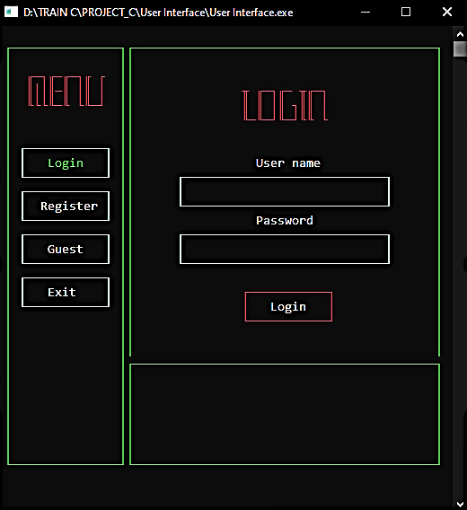

Calendar
01.04.2020
Our Calendar is officially released
aims to provide users with a good experience, along with eye-catching features and interfaces.
Team 3 Calendar – F code

Slide 20
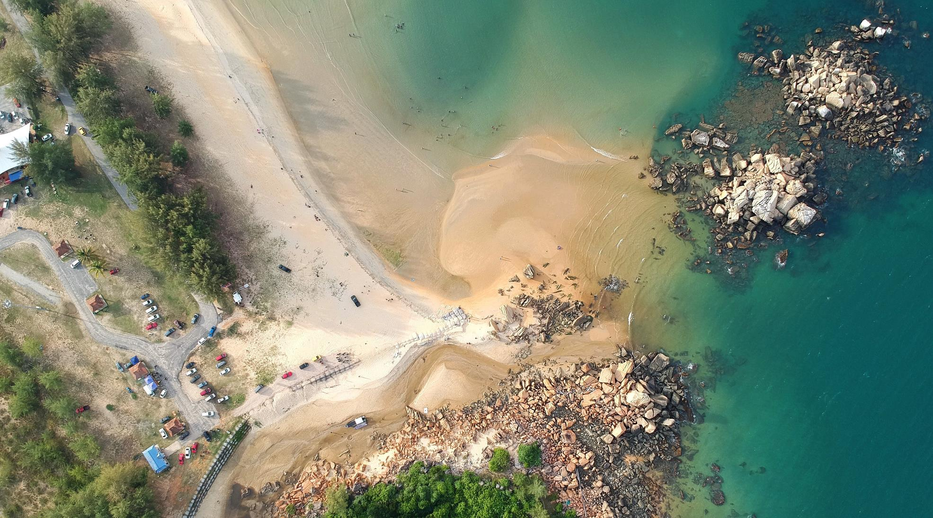

Thank You
TEAM 3
F – Code
Lam Nguyen
Dang Phuong Anh
Vinh Nguyen

